Slide 1
DESIGN OF ULTRA VIOLET INTENSITY AND THERMAL RADIATION MONITORING WEARABLE under the guidance of dr.a.v.ananthalakshmi
By
Sharmitha G
Muralidharan V
Arunn Mohan M
Hari Prasanna V

Slide 2

CONTENTS
Introduction
Literature Survey
Aim
Objective
Components
Pinout diagram
Working and operation
Merits and Applications
References

Slide 3
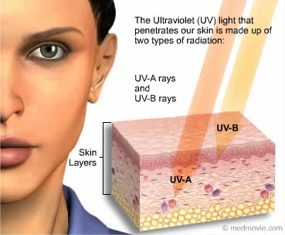

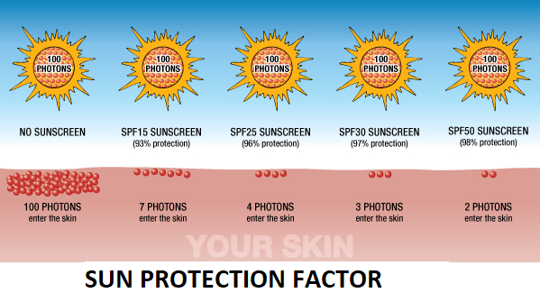
INTRODUCTION
UV radiation affects the epidermal and dermal layer of the skin. UV radiation accelerates skin aging, and the gradual loss of the skin's elasticity resulting in wrinkles and dry, coarse skin.
Proper precautions for specific UV radiations are not taken with respect to the intensity of UV rays. The change in the pigmentation of the skin is not noted currently using any device.
UV care wearable will act as a skin care gadget which protects us from harmful UV rays.

Slide 4
LITERATURE SURVEY
S.No. | TITLE OF THE PAPER OR JOURNAL | DETAILS OF PAPER OR JOURNAL | INFERENCE
1. | Design of Band-type Device to Measure UV Index and UVB Irradiance in Everyday | IEEE Paper; Park, D.-H., Kim, K.-M., Oh, S.-T., & Lim, J.-H. (2018). International Conference on Platform Technology and Service (PlatCon) | Methods to measure and compare UV index
2. | Design of an Ultraviolet Light Intensity Monitor for Personally Wearable Devices. | Chiang, C.-T., Chang, C.-M., & Chang, C.-C. (2018). IEEE Sensors Journal, 18(11), 4673–4678. | Conversion of UV intensity to UV index level and UV index scale
3. | UVA and UVB in sunlight, Optimal Utilization of UV rays in Sunlight for phototherapy. | Balasaraswathy P, Kumar U, Srinivas C R, Nair S. Indian Journal Dermatol Venereol Leprol. Year : 2002 | Volume : 68 | Issue : 4 | Page : 198-201 | Time of the day of UVB radiations, duration maximum intensity and skin cancer effects
4. | IR detectors: the next millennium | Rogalski, International Conference on Solid State Crystals 2000 Epilayers and Heterostructures in Optoelectronics and Semiconductor Technology, vol. 4413 of Proceedings of SPIE, pp. 307–322, October 2000. | IR temperature to thermographic range conversion

Slide 5
AIM To create a prototype of UV care wearable band for skin care and protection. OBJECTIVE The objective of this work is to design a prototype of UV care wearable band for skin care and protection. It is designed to display the UV index, thermal reaction of skin, skin pigmentation and skin cancer precautionary report.

Slide 6

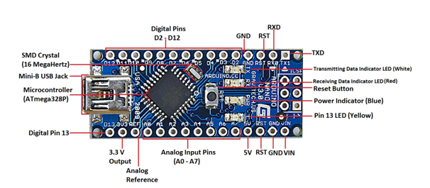
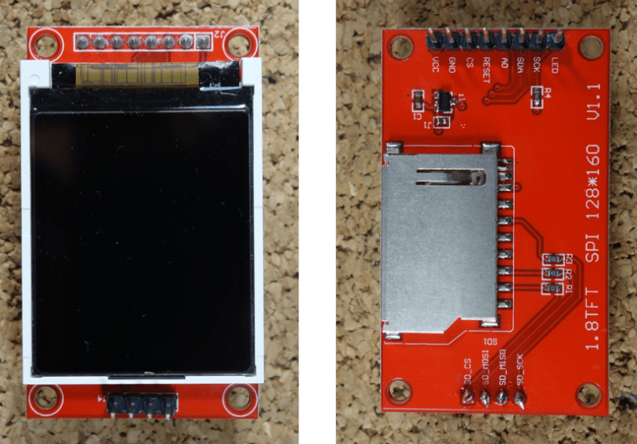
COMPONENTS
Arduino NANO
1.8 TFT LCD color display

Slide 7
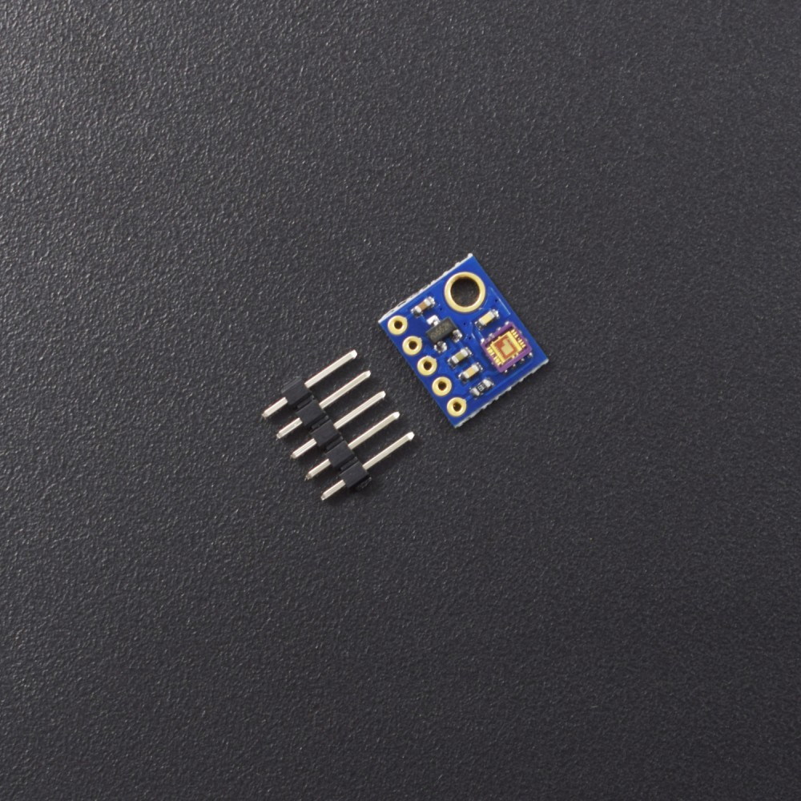
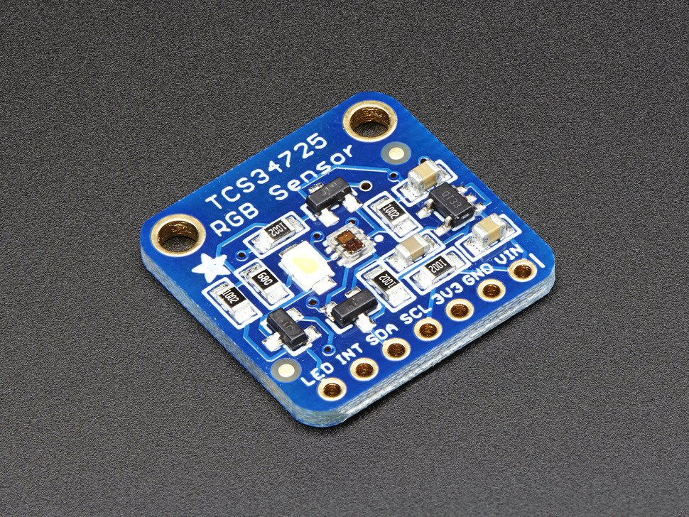
ML GY 8511 UV Sensor
TCS 34725 Colour sensor

Slide 8
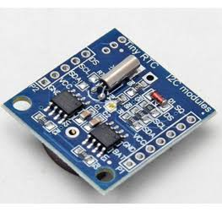
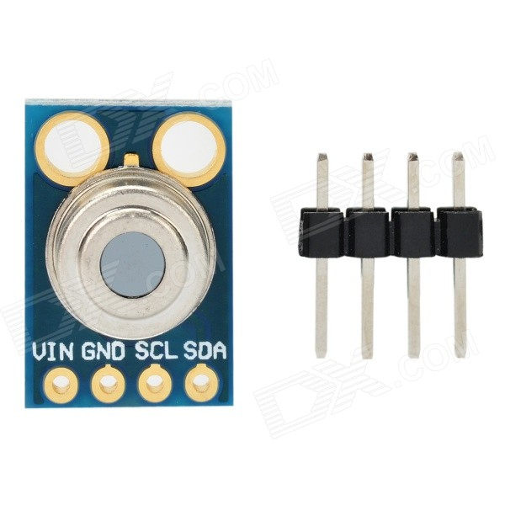
RTC DS1307
GY 906 IR temperature sensor

Slide 9
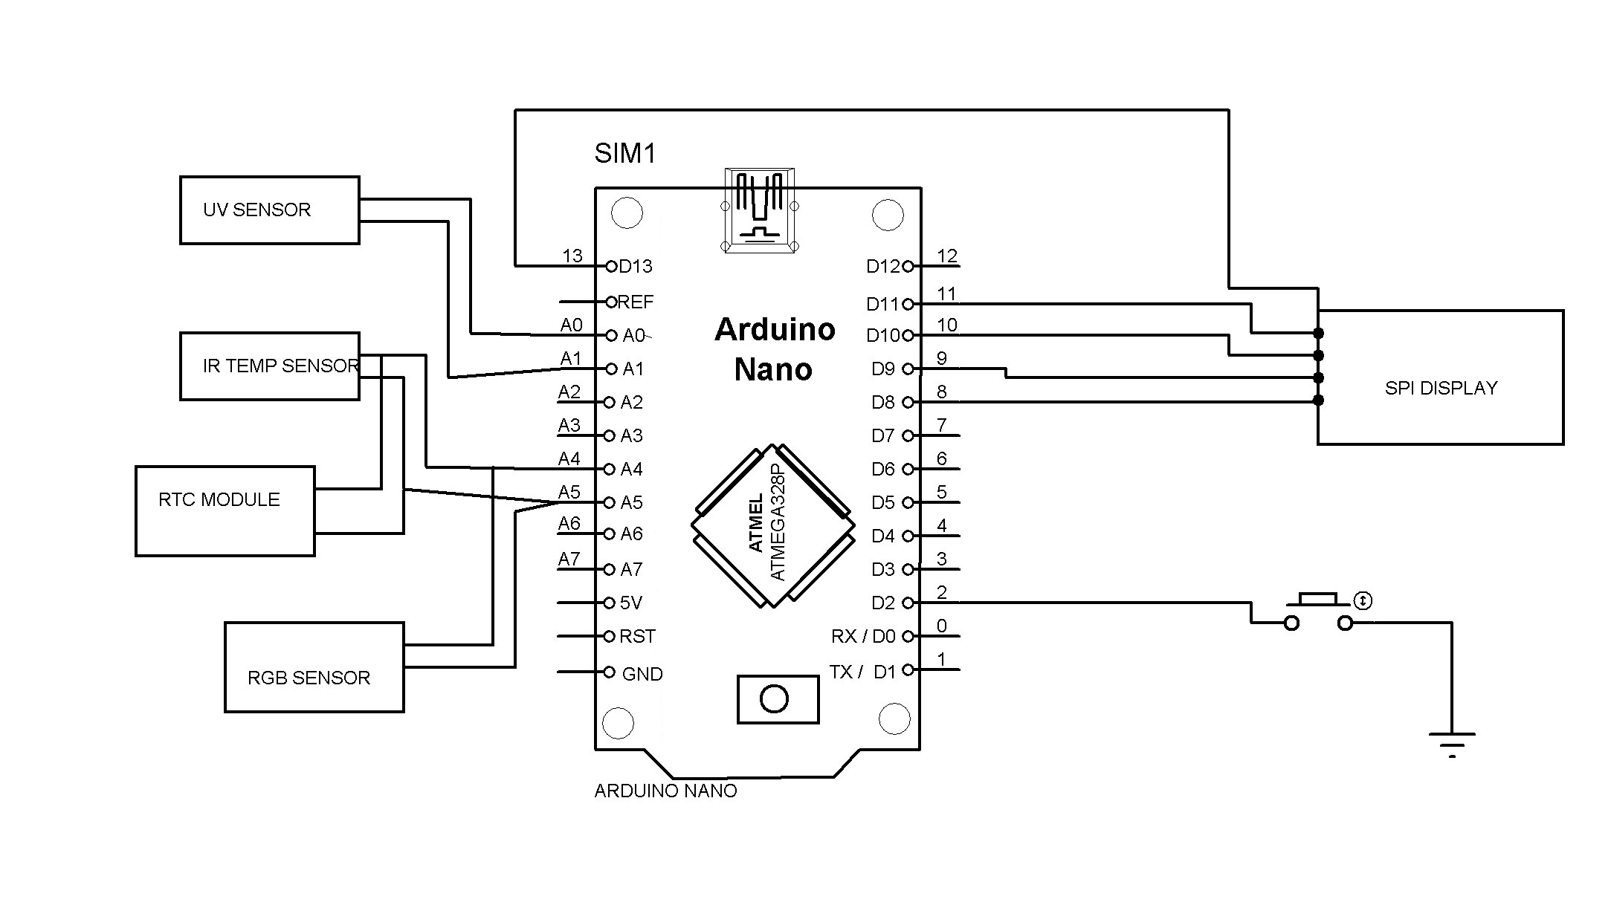
PINOUT DIAGRAM
*SOFTWARE USED IS ARDUINO 1.8.5

Slide 10
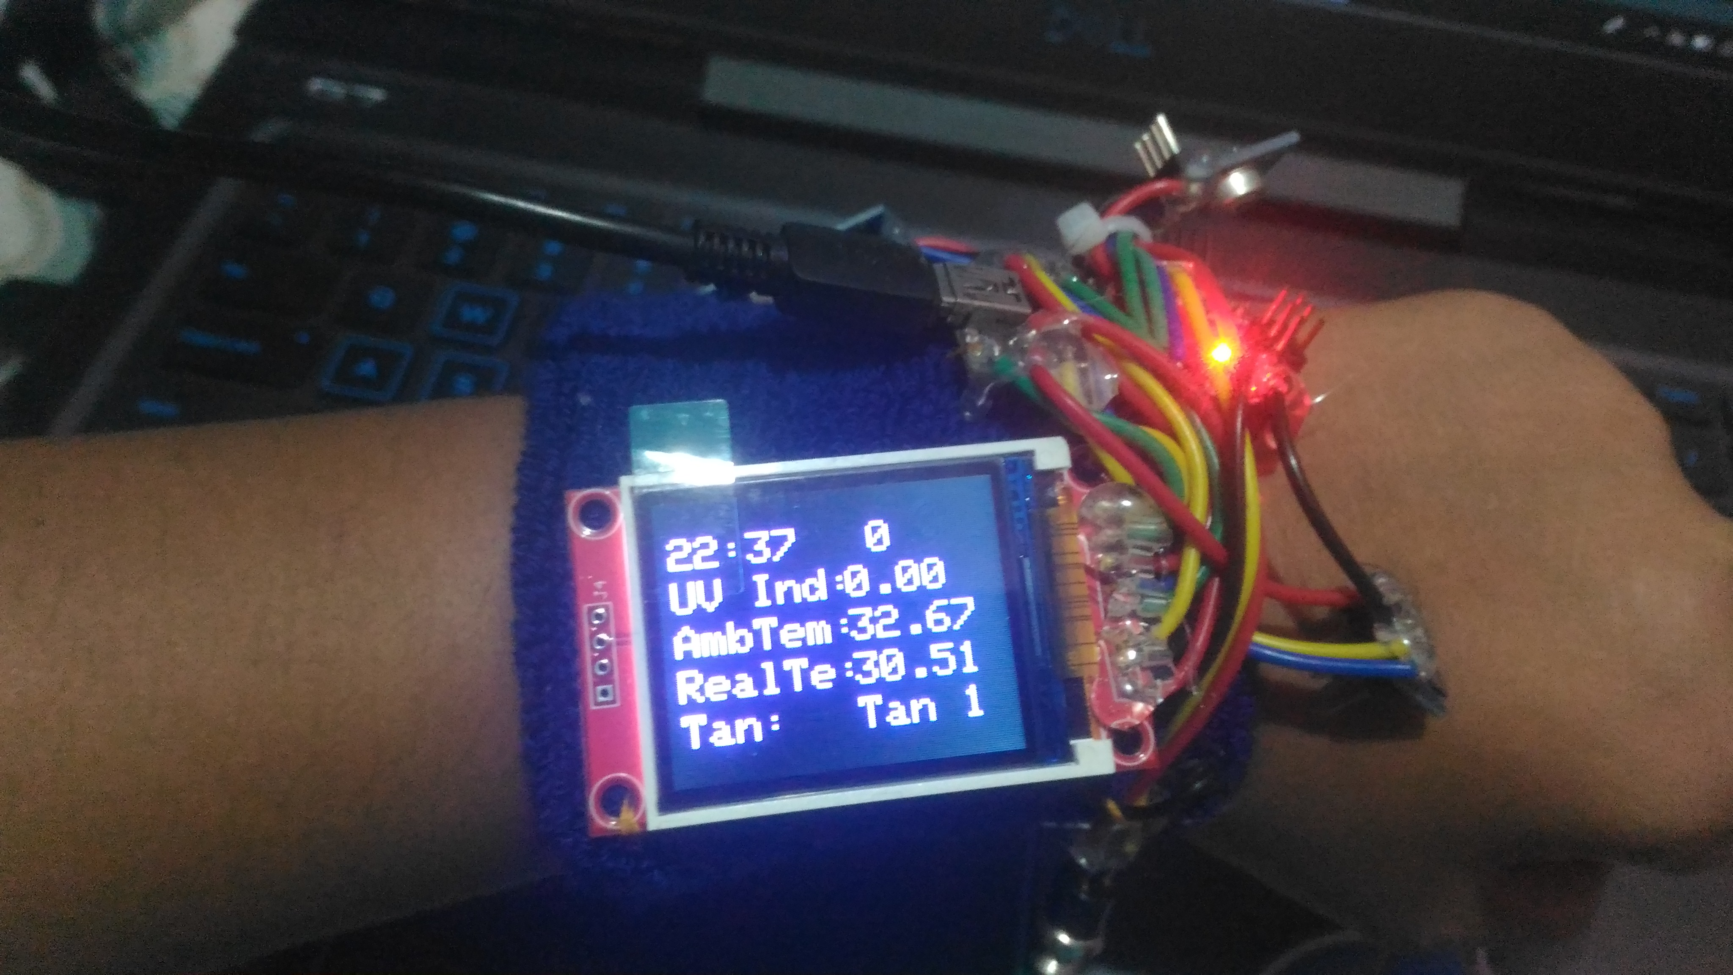
WORKING AND OPERATION
MODULE 1
The UV Index at intensity levels on a scale of 1 to 11+, where 1 indicates a minimal risk of overexposure and 11+ means a very high risk.
UV Sensor outputs an analog voltage that is linearly proportional to UV intensity(mW/cm^2) .
Arduino Nano inputs the UV intensity and outputs UV index.
The TFT display will show the UV index level.

Slide 11
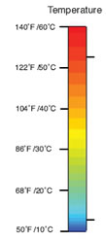
MODULE 2
IR Temperature sensor detects the temperature of the human skin . Arduino program has the range of thermographic values to the corresponding temperature.
The TFT display outputs the thermographic colour with temperature and displays necessary precautions.
The Colour sensor records the tanning level of our skin using its RGBC to digital converted values.

Slide 12
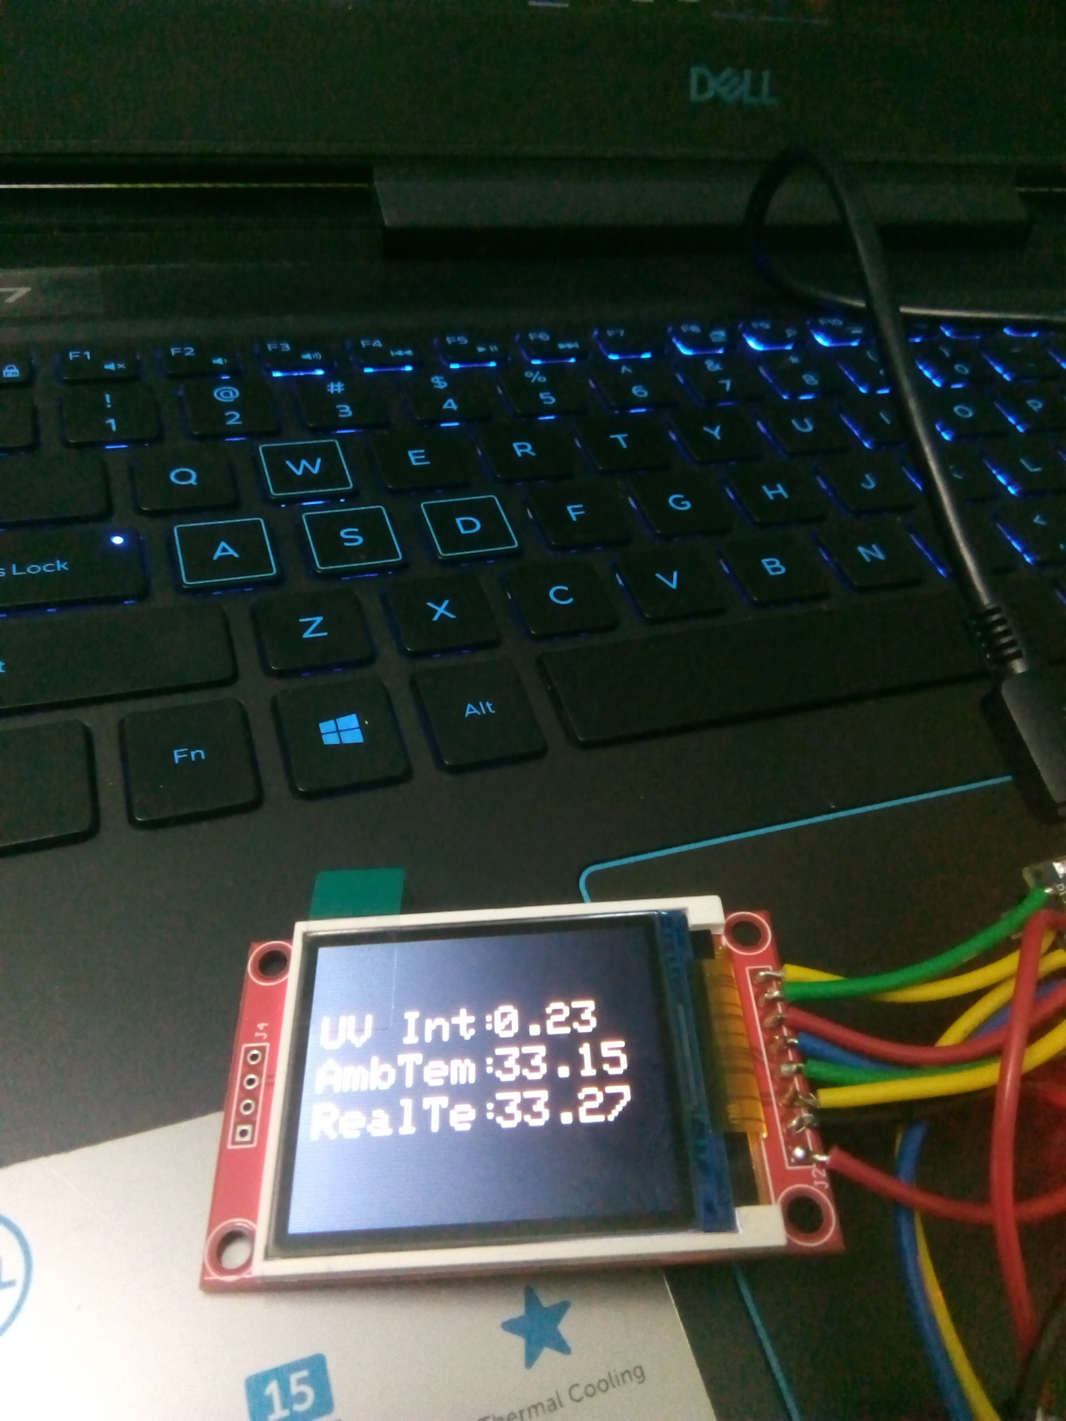
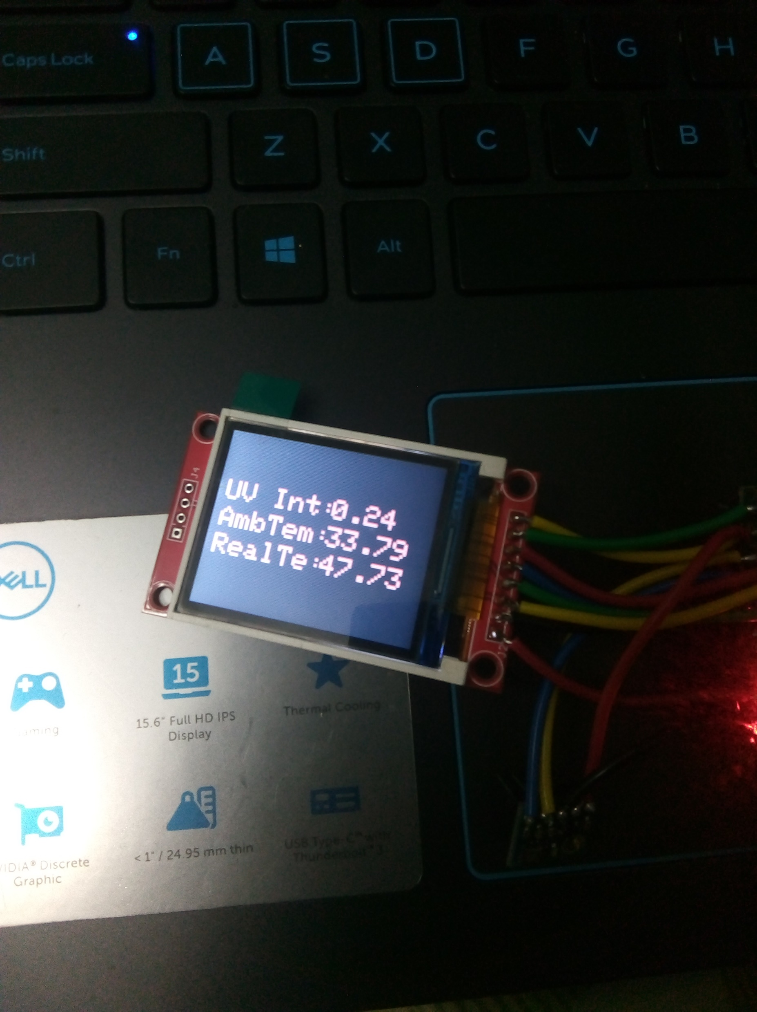
Readings taken indoor
and on warm surface.
Readings taken indoor
and on hot surface.

Slide 13
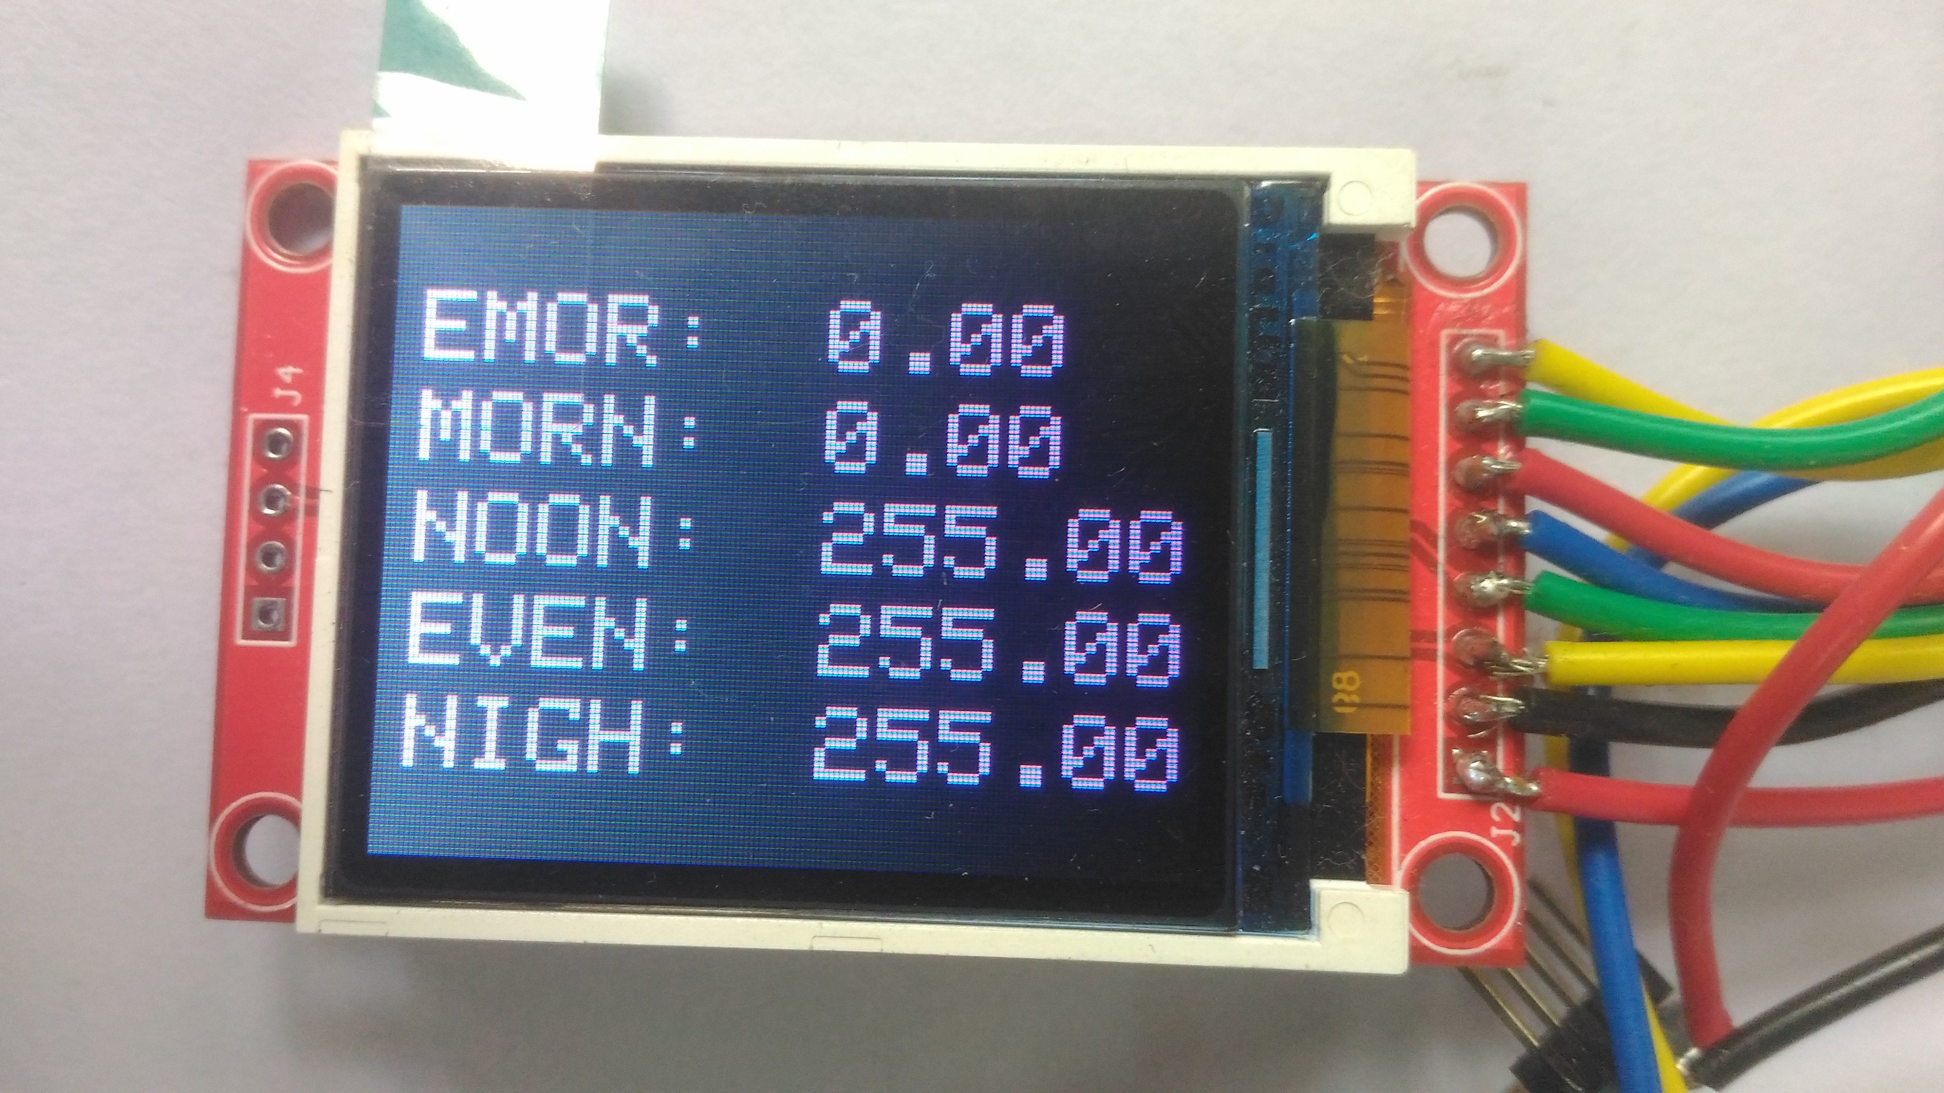
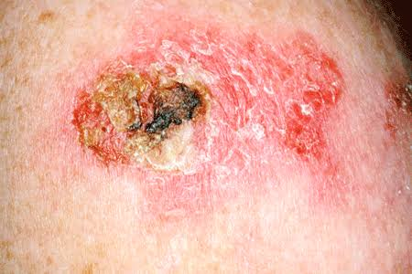
MODULE 3
The measured UV index and the time of the day will be analysed and the TFT displays a report of previous UV index levels.
If a user spends 1/3 rd of a day in the UV Index range of 6 to 10, it leads to melanoma and basal cell carcinoma conditions.

Slide 14
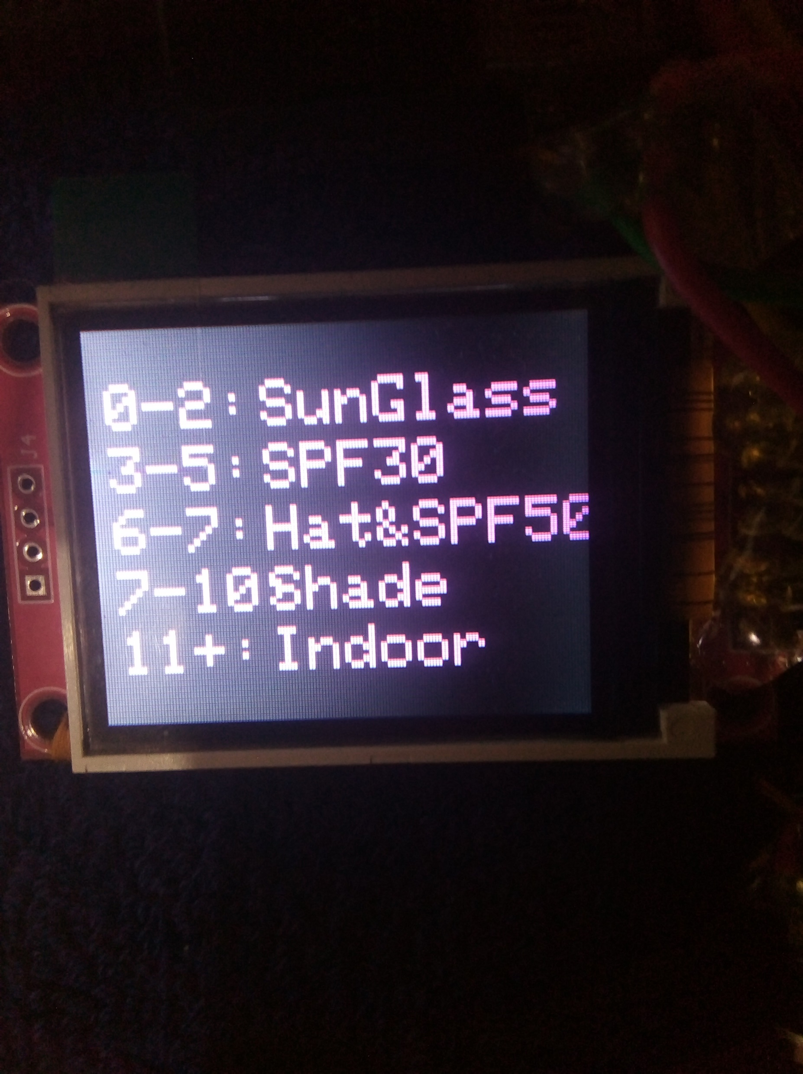
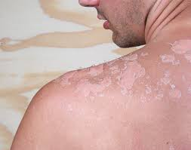
MODULE 4
It also suggests tips for skin care from UV radiation.
The appropriate SPF levels are also indicated.
Inappropriate Sunscreens are also found to be causing malicious effects on skin.

Slide 15
MERITS
The UV Wearable helps us to take additional care of our skin.
It provides precautions of how to handle extreme UV radiation.
FUTURE SCOPE
It can be incorporated with fitbit bands and in smart watches.
It can be extremely useful in countries with ozone depleted ` regions.(AUSTRALIA and NEWZEALAND)

Slide 16

REFERENCES
Dae-Hwan Park ; Kyeong-Mi Kim ; Seung-Taek Oh ; Jae-Hyun Lim “Design of Band-type Device to Measure UV Index and UVB Irradiance in Everyday”, 2018 International Conference on Platform Technology and Service (PlatCon) 29-31 Jan. 2018.Publisher: IEEE
Chiang, C.-T., Chang, C.-M., & Chang, C.-C. (2018). Design of an Ultraviolet Light Intensity Monitor for Personally Wearable Devices. IEEE Sensors Journal, 18(11), 4673–4678.
Rivas. Ml, MC. Araya, F. Caba, E. Rojas, GM. Calaf, "Ultraviolet light exposure influences skin cancer in association with latitude", Oncol Rep. 2011, vol. 25, no. 4, pp. 1153-9.
Balasaraswathy P, Kumar U, Srinivas C R, Nair S. UVA and UVB in sunlight, Optimal Utilization of UV rays in Sunlight for phototherapy. Indian J Dermatol Venereol Leprol 2002;68:198-201
Rogalski, "IR detectors: the next millennium," in International Conference on Solid State Crystals 2000 Epilayers and Heterostructures in Optoelectronics and Semiconductor Technology, vol. 4413 of Proceedings of SPIE, pp. 307–322, October 2000.

Slide 17
THANK YOU

